Slide 1


Tech ABC Corp - HR Database
[Arjun Avalakki Mohan & 25/05/2026]

Slide 2
Business Scenario
Business requirement
Tech ABC Corp saw explosive growth with a sudden appearance onto the gaming scene with their new AI-powered video game console. As a result, they have gone from a small 10 person operation to 200 employees and 5 locations in under a year. HR is having trouble keeping up with the growth, since they are still maintaining employee information in a spreadsheet. While that worked for ten employees, it has becoming increasingly cumbersome to manage as the company expands.
As such, the HR department has tasked you, as the new data architect, to design and build a database capable of managing their employee information.
Dataset
The HR dataset you will be working with is an Excel workbook which consists of 206 records, with eleven columns. The data is in human readable format, and has not been normalized at all. The data lists the names of employees at Tech ABC Corp as well as information such as job title, department, manager's name, hire date, start date, end date, work location, and salary.
IT Department Best Practices
The IT Department has certain Best Practices policies for databases you should follow, as detailed in the Best Practices document.

Slide 3
Step 1
Data Architecture Foundations

Slide 4
Step 1: Data Architecture Foundations
Hi,
Welcome to Tech ABC Corp. We are excited to have some new talent onboard. As you may already know, Tech ABC Corp has recently experienced a lot of growth. Our AI powered video game console WOPR has been hugely successful and as a result, our company has grown from 10 employees to 200 in only 6 months (and we are projecting a 20% growth a year for the next 5 years). We have also grown from our Dallas, Texas office, to 4 other locations nationwide: New York City, NY, San Francisco, CA, Minneapolis, MN, and Nashville, TN.
While this growth is great, it is really starting to put a strain on our record keeping in HR. We currently maintain all employee information on a shared spreadsheet. When HR consisted of only myself, managing everyone on an Excel spreadsheet was simple, but now that it is a shared document I am having serious reservations about data integrity and data security. If the wrong person got their hands on the HR file, they would see the salaries of every employee in the company, all the way up to the president.
After speaking with Jacob Lauber, the manager of IT, he suggested I put in a request to have my HR Excel file converted into a database. He suggested I reach out to you as I am told you have experience in designing and building databases. When you are building this, please keep in mind that I want any employee with a domain login to be have read only access the database. I just don't want them having access to salary information. That needs to be restricted to HR and management level employees only. Management and HR employees should also be the only ones with write access. By our current estimates, 90% of users will be read only.
I also want to make sure you know that am looking to turn my spreadsheet into a live database, one I can input and edit information into. I am not really concerned with reporting capabilities at the moment. Since we are working with employee data we are required by federal regulations to maintain this data for at least 7 years; additionally, since this is considered business critical data, we need to make sure it gets backed up properly.
As a final consideration. We would like to be able to connect with the payroll department's system in the future. They maintain employee attendance and paid time off information. It would be nice if the two systems could interface in the future
I am looking forward to working with you and seeing what kind of database you design for us.
Thanks,
Sarah Collins
Head of HR

Slide 5
Data Architect Business Requirement
Purpose of the new database:
The purpose of the new database is to provide HR with a secure and reliable system to manage employee information as the company continues to grow. It is intended to replace the current shared spreadsheet, improve data integrity and security, and provide a live system where employee information can be updated and maintained more efficiently.
Describe current data management solution:
The current HR solution is based on a shared spreadsheet.
- Employee data is stored in Excel.
- The spreadsheet is manually maintained by HR.
- The solution is becoming difficult to manage as the company grows.
- There are concerns around data security and data integrity.
Describe current data available:
The current spreadsheet contains employee information including:
- Employee ID
- Employee name - Email address - Hire date - Job title - Department
- Manager name - Salary - Start and end dates - Work location details - Education level

Slide 6
Data Architect Business Requirement
Additional data requests:
The HR department would like the database to support future integration with the payroll system. Future integration may include:
- Employee attendance information
- Paid time off (PTO) information
- Payroll-related employee data
Who will own/manage data
The HR department will own and manage the employee data stored in the database. Responsibilities includes:
- Maintaining employee records
- Managing updates and corrections
- Controlling access to sensitive information
- Ensuring employee information remains accurate and up to date
Who will have access to database
The database will be accessible to employees with a company domain login. Access restrictions will include:
- General employees will have read-only access
- HR and management employees will have write access
- Salary information will be restricted to HR and management users only

Slide 7
Data Architect Business Requirement
Estimated size of database
The current database is expected to contain approximately:
- 205 employee records (rows)
- 15 data fields (columns)
Estimated annual growth
The business is projecting approximately:
- 20% annual growth in employee data
- Continued expansion across multiple office locations over the next 5 years
Is any of the data sensitive/restricted
The following information should be treated as sensitive and restricted:
- Employee salary information
- Employee personal information
- HR management and reporting structure information

Slide 8
Data Architect Technical Requirement
Justification for the new database
The new database is required to:
- Improve data security and restrict access to sensitive salary information
- Improve data integrity and reduce risks caused by manual spreadsheet updates
- Support future business growth and increasing employee records
- Provide a centralized system for managing employee information
Database objects
The database will include the following objects:
- Employee table
- Department table
- Job title table
- Location table
- Education level table
- Employee job history table
- Employee salary table
Data ingestion
The proposed data ingestion method is “ETL (Extract, Transform, Load)”. This approach is suitable because the current employee data is stored in Excel spreadsheets and will need to be cleaned and loaded into the new database.

Slide 9
Data Architect Technical Requirement
Data governance (Ownership and User access)
Ownership: HR will own and maintain the employee data. IT will manage database security, backups, and access control.
User Access: General employees will have read-only access. HR and management users will have read and write access. Salary information will only be accessible to HR and management users.
Scalability
Replication or sharding is not required at this stage. The database size is small, and expected growth can be handled by a standard relational database design.
Flexibility
The database will use unique employee IDs to support future system integration. Data will be stored in normalized tables to support future payroll integration.
Storage & retention
Storage (disk or in-memory): Disk-based storage will be used for the database.
Retention: Employee data must be retained for a minimum of 7 years.
Backup
- Weekly full and Daily incremental backups will be performed.
- Backups are required because the database contains business critical HR data

Slide 10
Step 2
Relational Database Design

Slide 11
Step 2: Relational Database Design
This step is where you will go through the process of designing a new database for Tech ABC Corp's HR department. Using the dataset provided, along with the requirements gathered in step one, you are going to develop a relational database set to the 3NF.
Using Lucidchart, you will create 3 entity relationship diagrams (ERDs) to show how you developed the final design for your data.
You will submit a screenshot for each of the 3 ERDs you create. You will find detailed instructions for developing each of the ERDs over the next several pages.

Slide 12
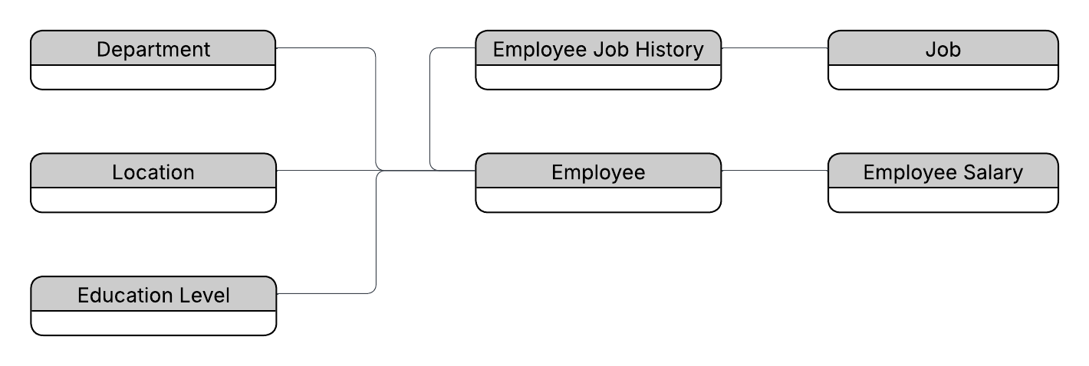
ERD
Conceptual
This is the most general level of data modeling. At the conceptual level, you should be thinking about creating entities that represent business objects for the database. Think broadly here. Attributes (or column names) are not required at this point, but relationship lines are required (although Crow's foot notation is not needed at this level). Create at least three entities for this model; thinking about the 3NF will aid you in deciding the type of entities to create.
Use Lucidchart’s built-in template for DBMS ER Diagram UML.

Slide 13
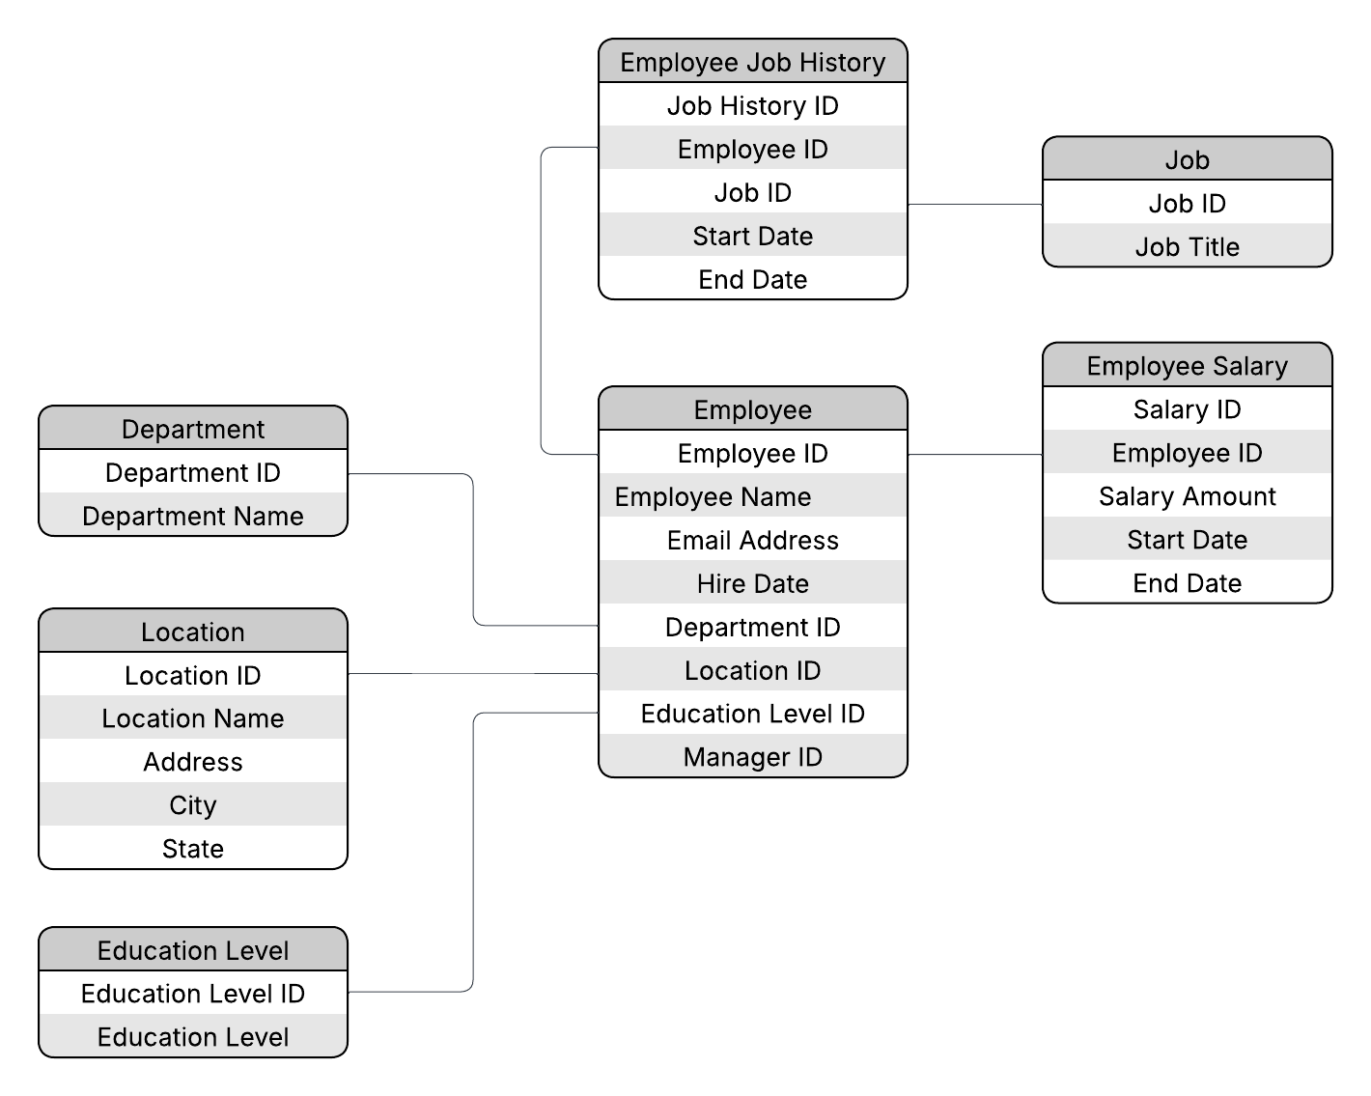
ERD
Logical
The logical model is the next level of refinement from the conceptual ERD. At this point, you should have normalized the data to the 3NF. Attributes should also be listed now in the ERD. You can still use human-friendly entity and attribute names in the logical model, and while relationship lines are required, Crow's foot notation is still not needed at this point.
Use Lucidchart’s built-in template for DBMS ER Diagram UML.

Slide 14
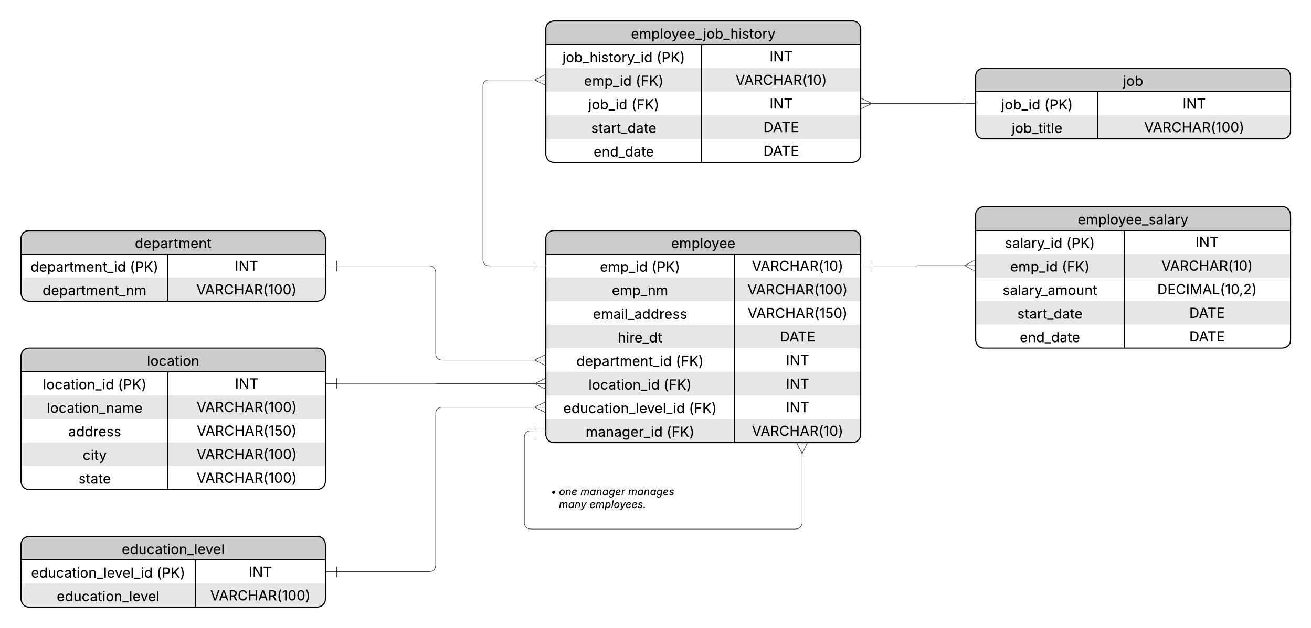
ERD
Physical
The physical model is what will be built in the database. Each entity should represent a database table, complete with column names and data types. Primary keys and foreign keys should also be represented here. Primary keys should be in bold type with the (PK) designation following the field name. Foreign keys should be in normal type face, but have the designation (FK) after the column name. Finally, in the physical model, Crow's foot notation is important.

Slide 15
Step 3
Create A Physical Database

Slide 16
Step 3: Create A Physical Database
In this step, you will be turning your database model into a physical database.
You will:
Create the database using SQL DDL commands
Load the data into your database, utilizing flat file ETL
Answer a series of questions using CRUD SQL commands to demonstrate your database was created and populated correctly
Submission
For this step, you will need to submit SQL files containing all DDL SQL scripts used to create the database.
You will also have to submit screenshots showing CRUD commands, along with results for each of the questions found in the starter template.
Hints
Your DDL script will be graded by running the code you submit. Please ensure your SQL code runs properly!
Foreign keys cannot be created on tables that do not exist yet, so it may be easier to create all tables in the database, then to go back and run modify statements on the tables to create foreign key constraints.
After running CRUD commands like update, insert, or delete, run a SELECT* command on the affected table, so the reviewer can see the results of the command.

Slide 17
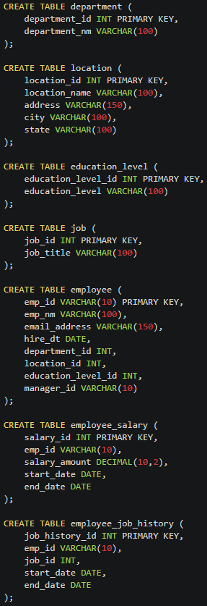
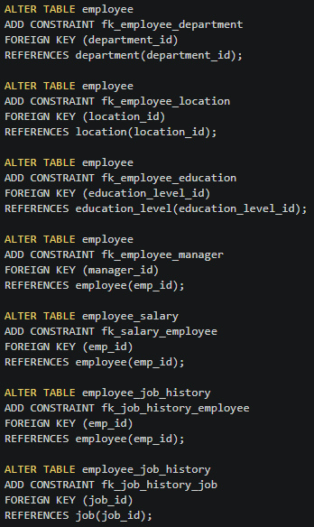
DDL
Create a DDL SQL script capable of building the database you designed in Step 2
01_create_tables.sql

Slide 18
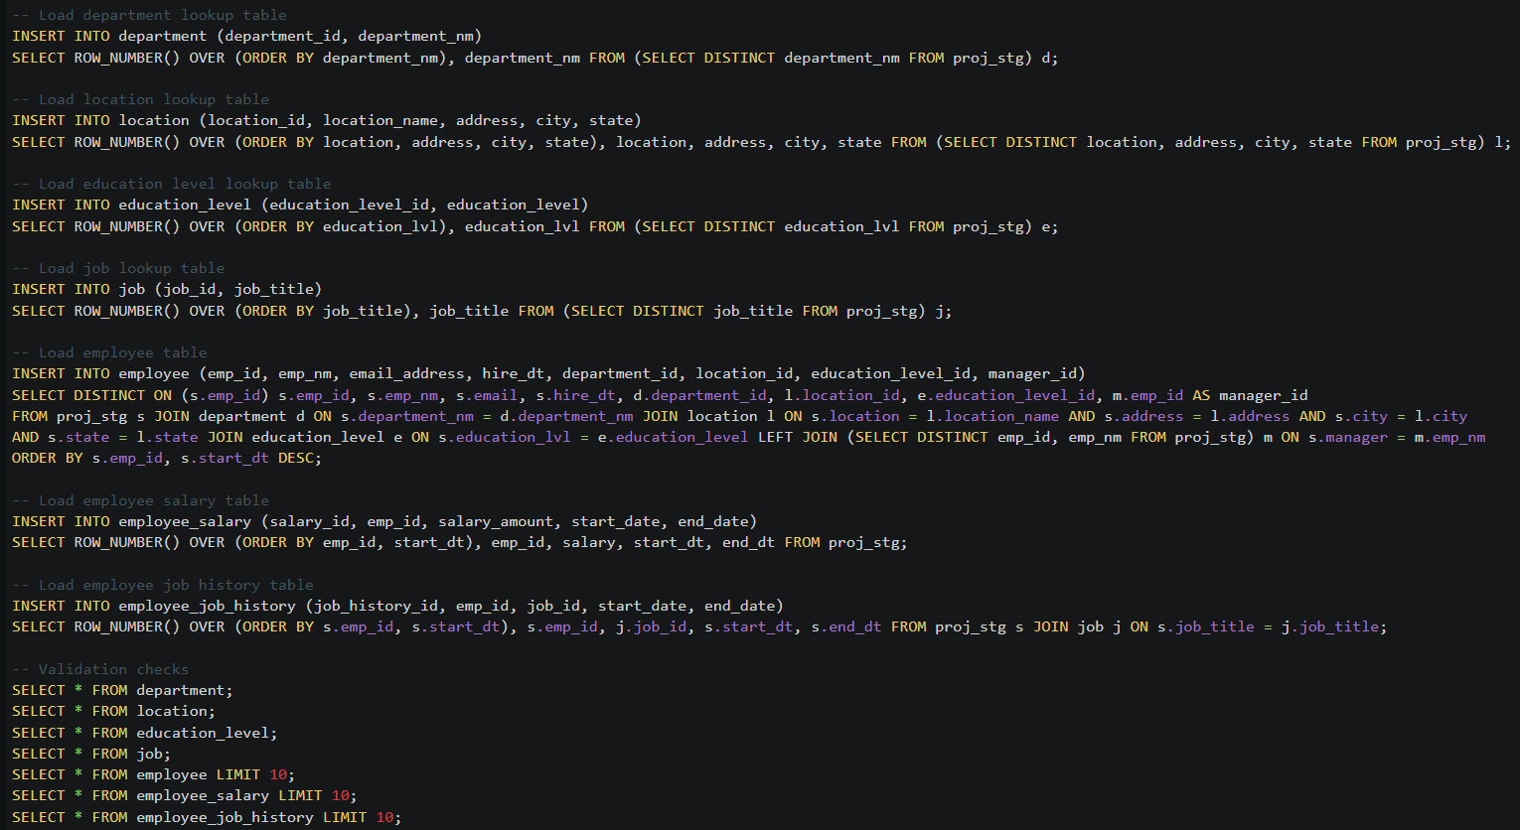
DDL
Create a DDL SQL script capable of building the database you designed in Step 2
02_etl_load_data.sql

Slide 19
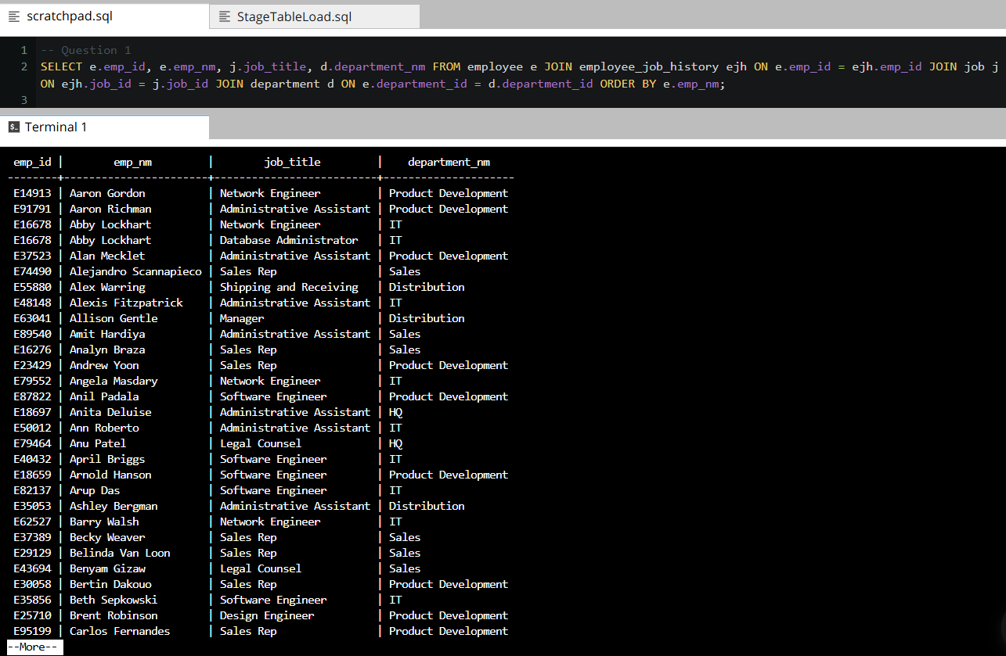
CRUD
Question 1: Return a list of employees with Job Titles and Department Names

Slide 20
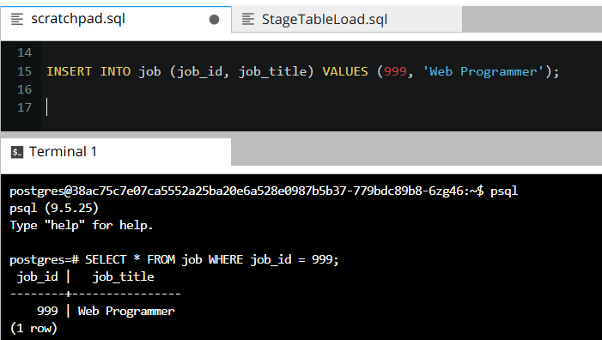
CRUD
Question 2: Insert Web Programmer as a new job title

Slide 21
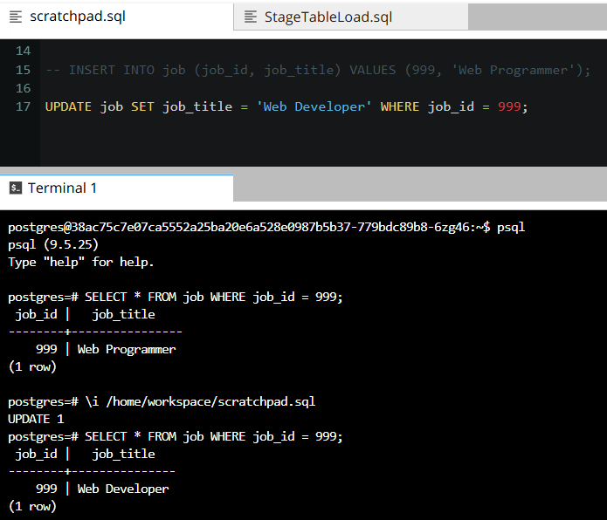
CRUD
Question 3: Correct the job title from web programmer to web developer

Slide 22
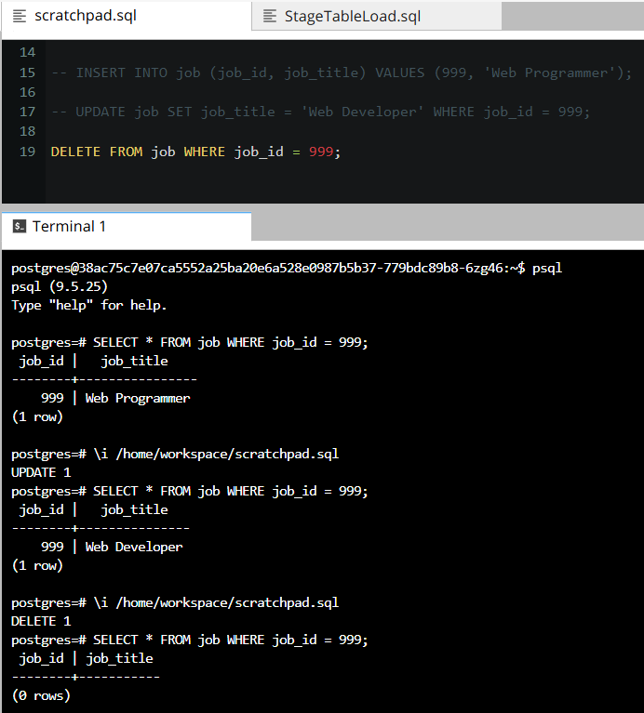
CRUD
Question 4: Delete the job title Web Developer from the database

Slide 23
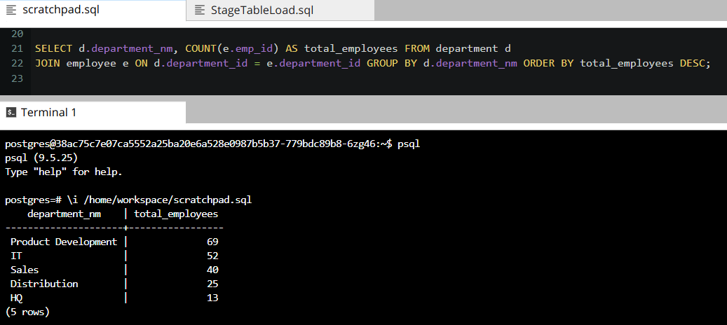
CRUD
Question 5: How many employees are in each department?

Slide 24
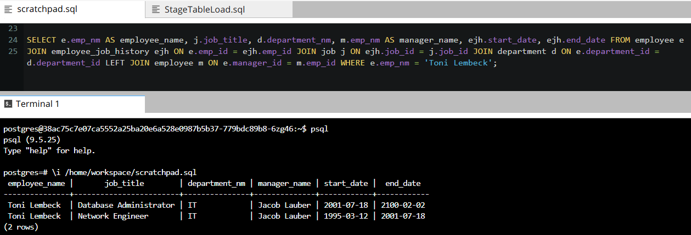
CRUD
Question 6: Write a query that returns current and past jobs (include employee name, job title, department, manager name, start and end date for position) for employee Toni Lembeck.

Slide 25
CRUD
Question 7: Describe how you would apply table security to restrict access to employee salaries using an SQL server.
I would apply table-level security by creating separate database roles for normal users and HR or management users. Normal users should only have read-only access to non-sensitive tables such as employee, department, job, location, employee_job_history, and education_level. They should not have access to the employee_salary table.
Example SQL:
CREATE ROLE readonly_user;
GRANT SELECT ON employee, department, job, location, employee_job_history, education_level TO readonly_user;
REVOKE ALL ON employee_salary FROM readonly_user;
For HR and management users, I would create a separate role with access to salary information.
Example SQL:
CREATE ROLE hr_manager;
GRANT SELECT, INSERT, UPDATE ON employee_salary TO hr_manager;
GRANT SELECT, INSERT, UPDATE ON employee, department, job, location, employee_job_history, education_level TO hr_manager;
This approach ensures that only authorized users can access or update sensitive employee salary information.

